Slide 1
Slides: Lesson Three
Important: Use Presenter View to see speaker notes/suggested teacher script. (Go to lower left corner, click on the circle with three dots, and select “Use Presenter View.”)

Slide 2
Abd el-Kader to Elkader
revised 2021
Notes:
In this lesson, we’ll be heading back in time to learn about an extraordinary Muslim hero named Abd el-Kader.

Slide 3
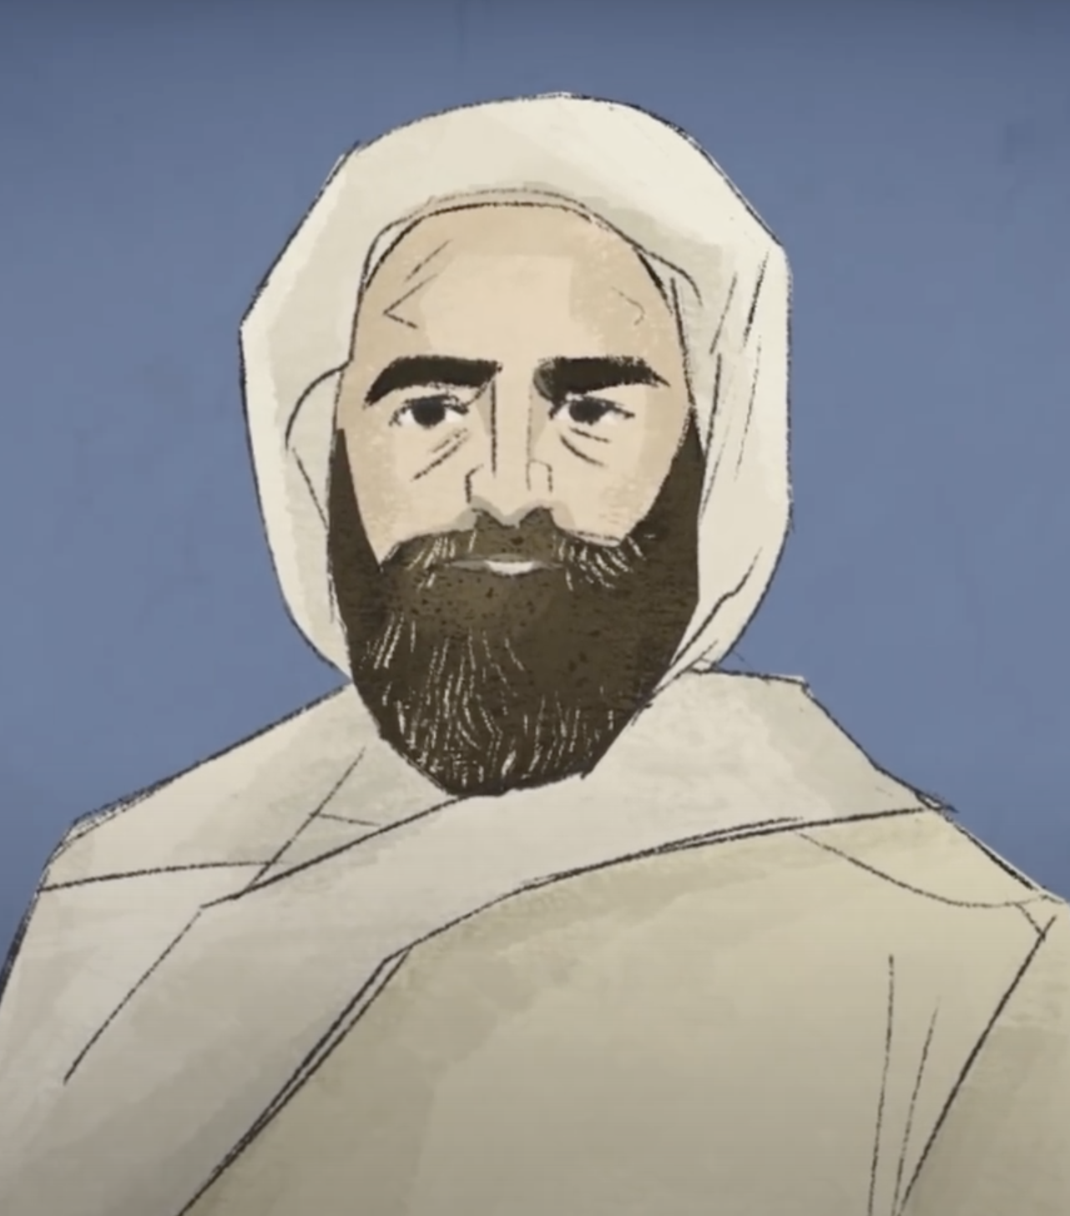
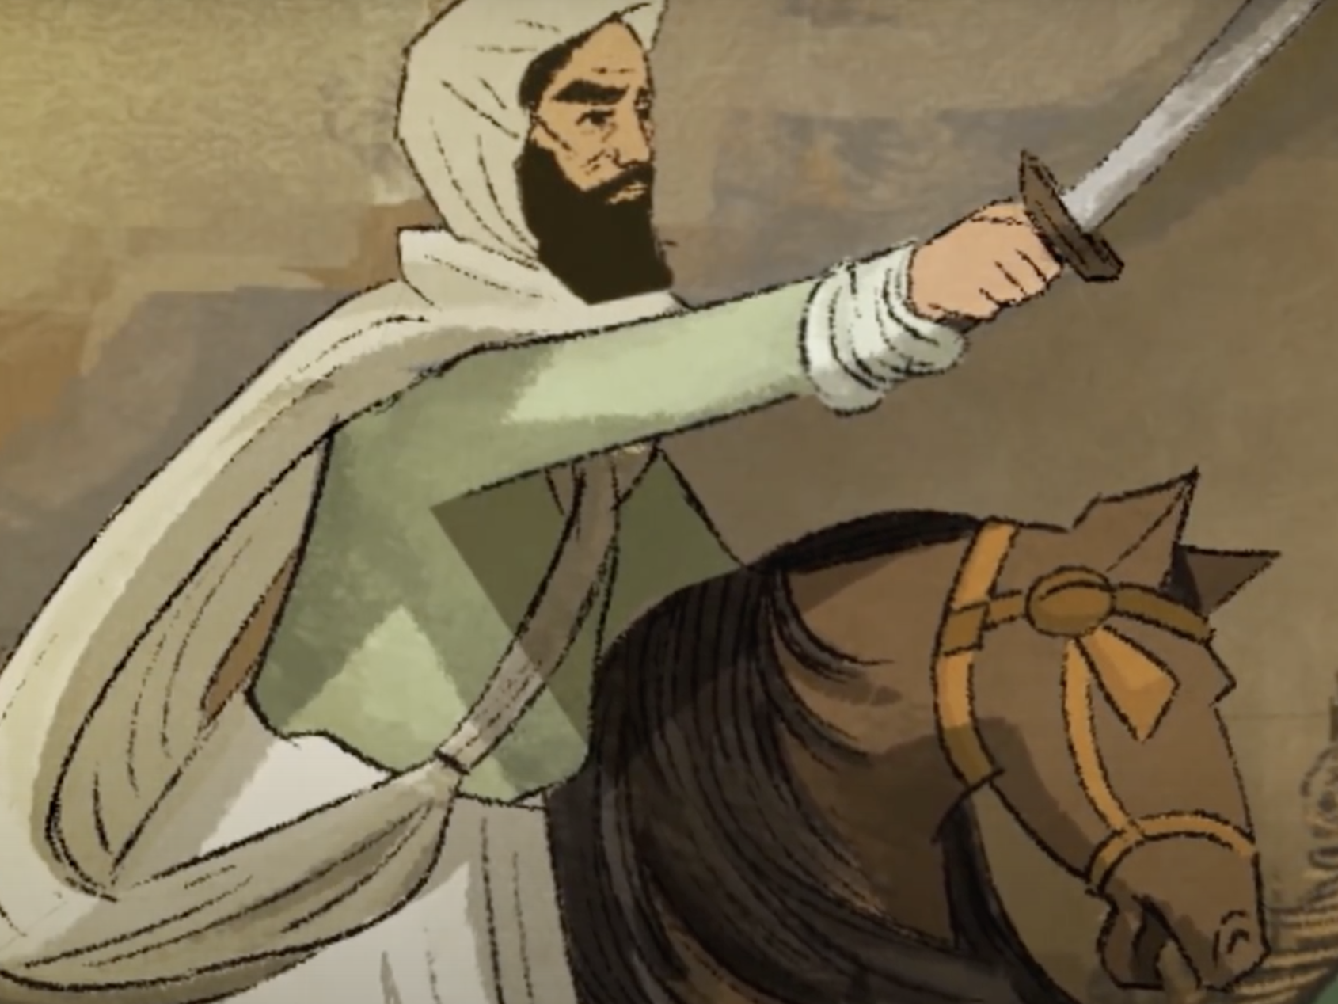
Who is Abd el-Kader? (Essential question: How do you become the person you want to be?)
Image credit: The Emir Stein Center
Notes:
Has anyone heard of Abd el-Kader? Can you guess from looking at these images when he lived, and where?

Slide 4
Part I: Time and Place
What was living like in 19th century Algeria?

Slide 5
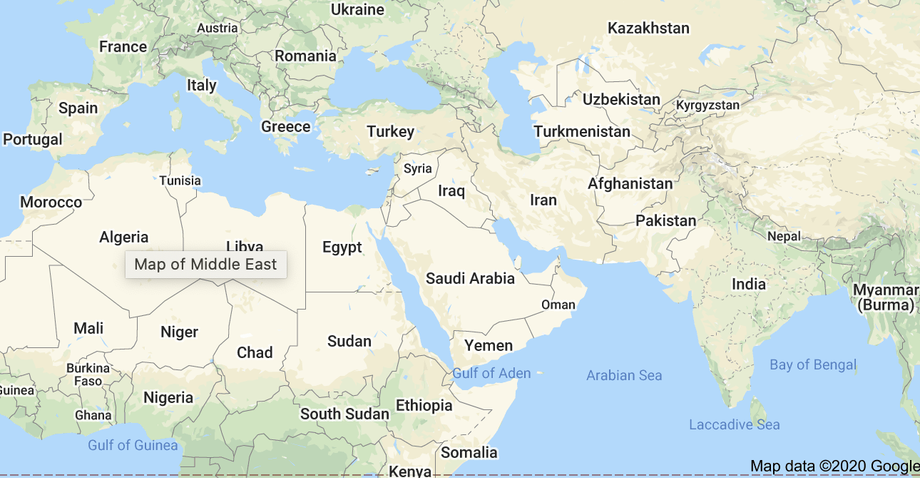
Mediterranean Sea
Notes:
Abd el-Kader lived in the Regency of Algiers, which was part of what we now call Algeria (blue arrow). At the time of Abd el-Kader’s birth (1808), the Regency of Algiers was part of the Ottoman Empire. At its height, the Ottoman Empire circled much of the Mediterranean Sea, but by the 19th century, the Empire was weak. The capital of the Ottoman Empire was in Constantinople, now Istanbul, Turkey (pink arrow). We’ll be talking more about the Ottoman Empire later in this lesson.

Slide 6
1808 - 1883
Notes:
1808-1883: What was happening in the United States during this time?

Slide 7
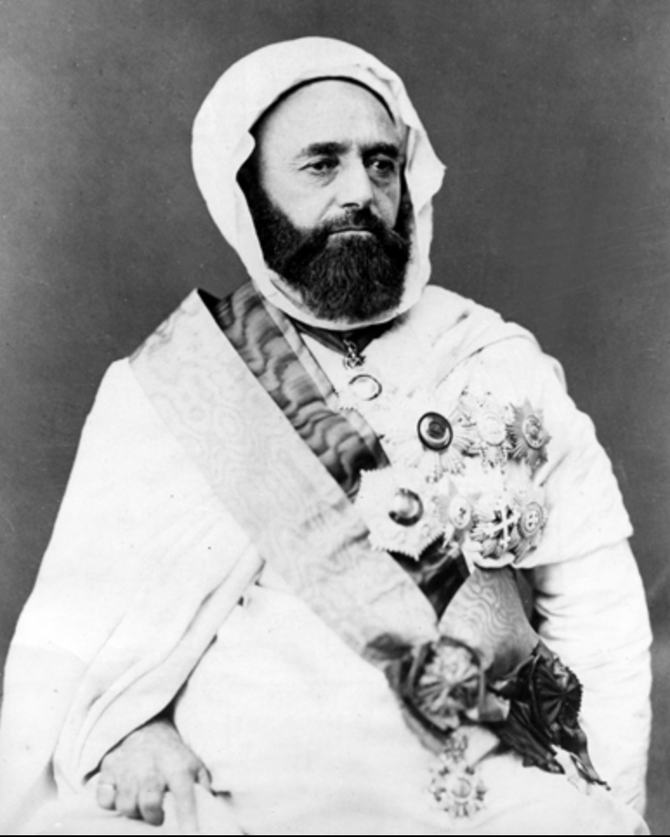
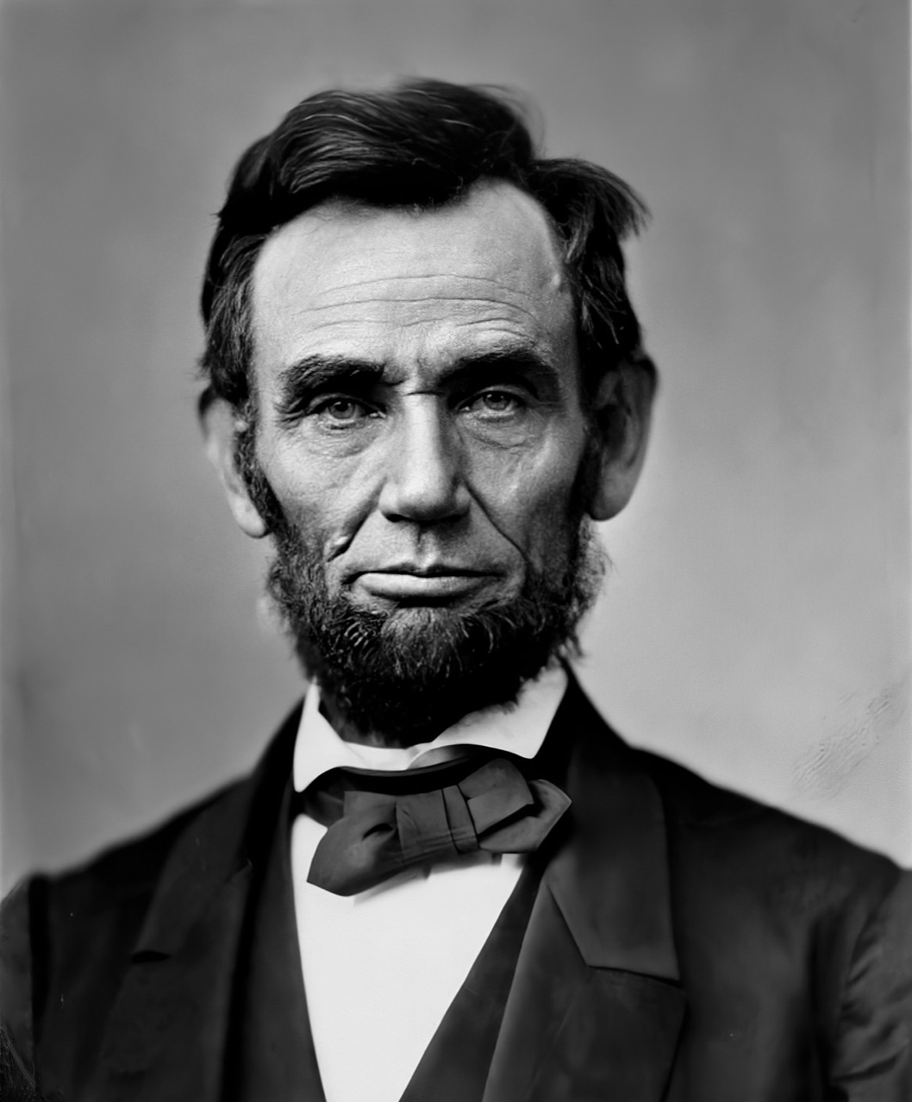
1809 - 1865 (assassinated)
American Civil War: 1861-65
1808 - 1883
Notes:
(Use this slide if necessary before continuing to the activity on Slides 6-12. Students might want to jot down these dates.)

Slide 8
Which of these events took place during Abd el-Kader’s lifetime (1808-1883)?
Tobacco farmer John Rolfe marries Pocohontas
James Madison becomes 4th president
The Oregon Trail
Baseball rules defined for the first time
Iowa becomes the 29th state
California Gold Rush begins
Notes:
On the next three slides are listed 16 events from U.S. history. On a piece of scrap paper (or the back of something else), write down the numbers of the events you think took place during Abd el-Kader’s lifetime. Some of these are events that you may not have learned about yet. That’s OK. We’re just trying to place Abd el-Kader in time.

Slide 9
Which of these events took place during Abd el-Kader’s lifetime (1808-1883)?
7. George Washington dies
8. Abraham Lincoln becomes the 16th president
9. Beginning of the U.S. Civil War
10. Abraham Lincoln assassinated
11. First baseball World Series
12. Yellowstone National Park established

Slide 10
Which of these events took place during Abd el-Kader’s lifetime (1808-1883)?
13. Blue jeans invented
14. Work begins on Mt Rushmore
15. Coca-Cola first sold in a bottle
16. Brooklyn Bridge opens

Slide 11
Which of these events took place during Abd el-Kader’s lifetime (1808-1883)?
Tobacco farmer John Rolfe marries Pocohontas (1614)
James Madison becomes 4th president (1809)
The Oregon Trail (1843)
Baseball rules defined for the first time (1845)
Iowa becomes the 29th state (1846)
California Gold Rush begins (1848)
Notes:
The events in yellow took place during Abd el-Kader’s lifetime.

Slide 12
Which of these events took place during Abd el-Kader’s lifetime (1808-1883)?
7. George Washington dies (1799)
8. Abraham Lincoln becomes the 16th president (1861)
9. Beginning of the U.S. Civil War (1861)
10. Abraham Lincoln assassinated (1865)
11. First baseball World Series (1903)
12. Yellowstone National Park established (1872)

Slide 13
Which of these events took place during Abd el-Kader’s lifetime (1808-1883)?
13. Blue jeans invented (1873)
14. Work begins on Mt Rushmore (1927)
15. Coca-Cola first sold in a bottle (1894)
16. Brooklyn Bridge opens (1883)
Notes:
Since 11 of the 16 events happened during AEK’s lifetime, 11 is a perfect score. (Take a few minutes to go back through Slides 10-12, focusing on the events in yellow. These are the events that happened in the U.S. during Abd el-Kader’s lifetime.)

Slide 14
Mediterranean Sea
Notes:
The previous activity helped us place Abd el-Kader in time. Now let’s look at some images of present-day Algeria. Which photographs look as if they could be taken in Iowa? Elsewhere in the United States? Which photos are completely different from anything in our country?

Slide 15
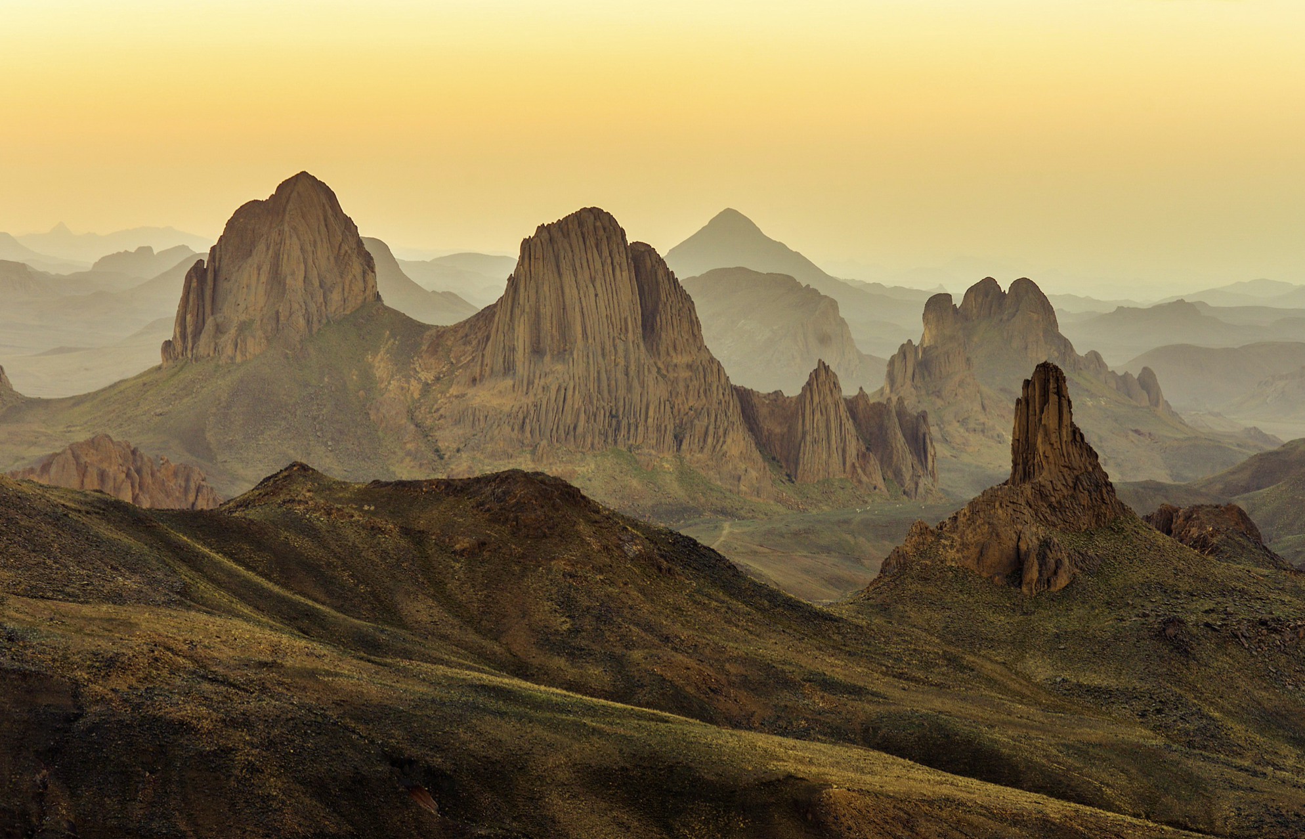
Notes:
Hoggar National Park, Algeria

Slide 16
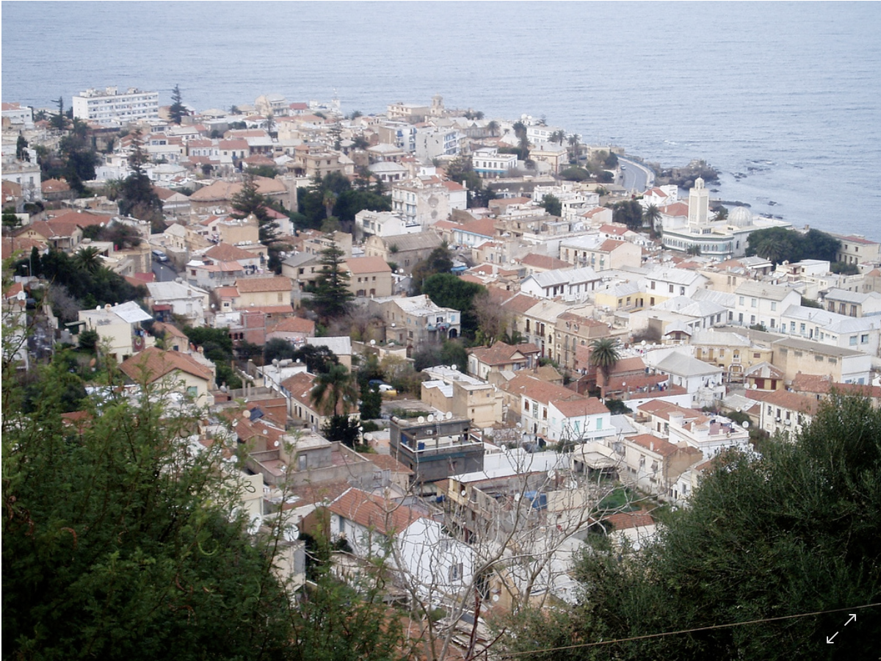
Notes:
Algiers, Algeria

Slide 17
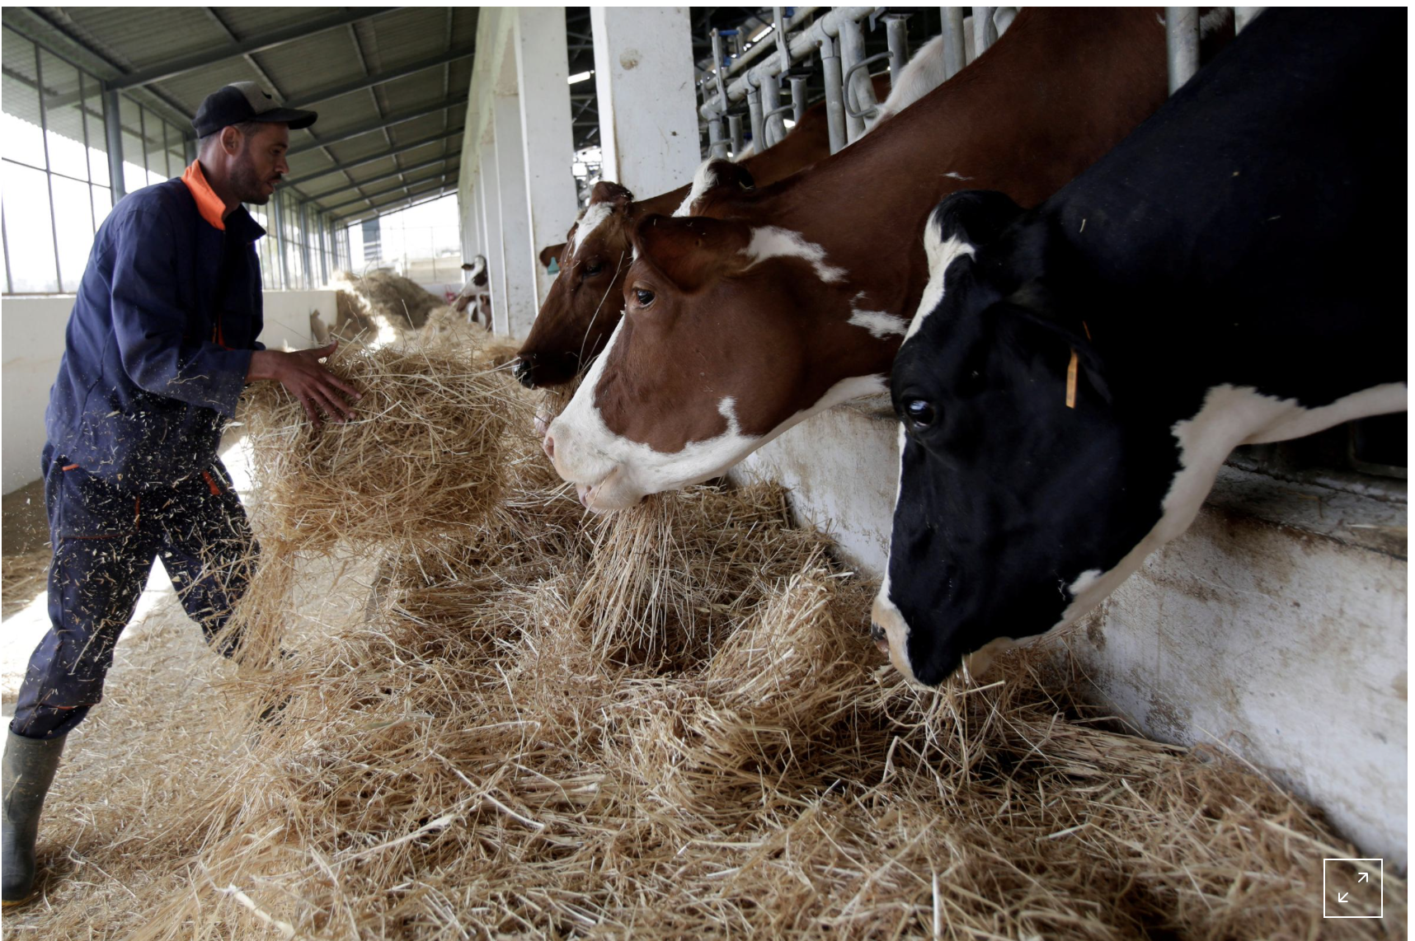
Notes:
Tipaza, Algeria

Slide 18
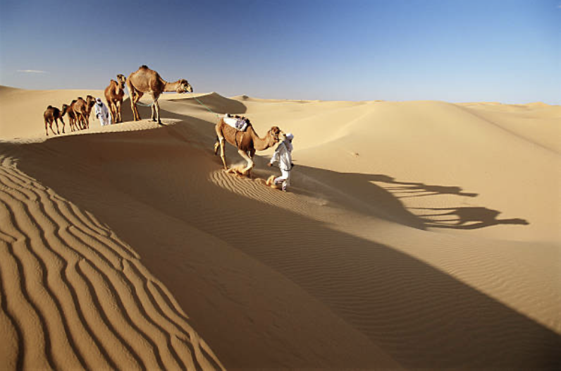
Notes:
Camel trek in the Sahara, Algeria

Slide 19
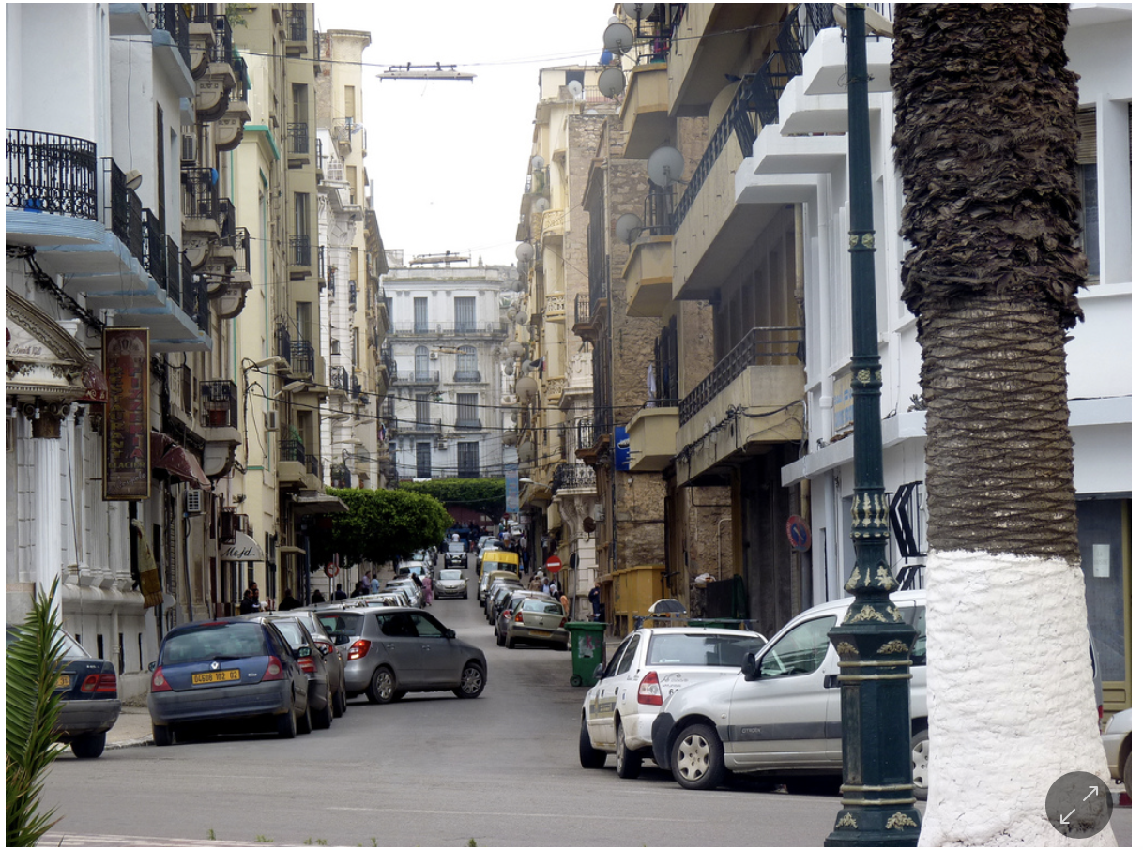
Notes:
Oran, Algeria

Slide 20
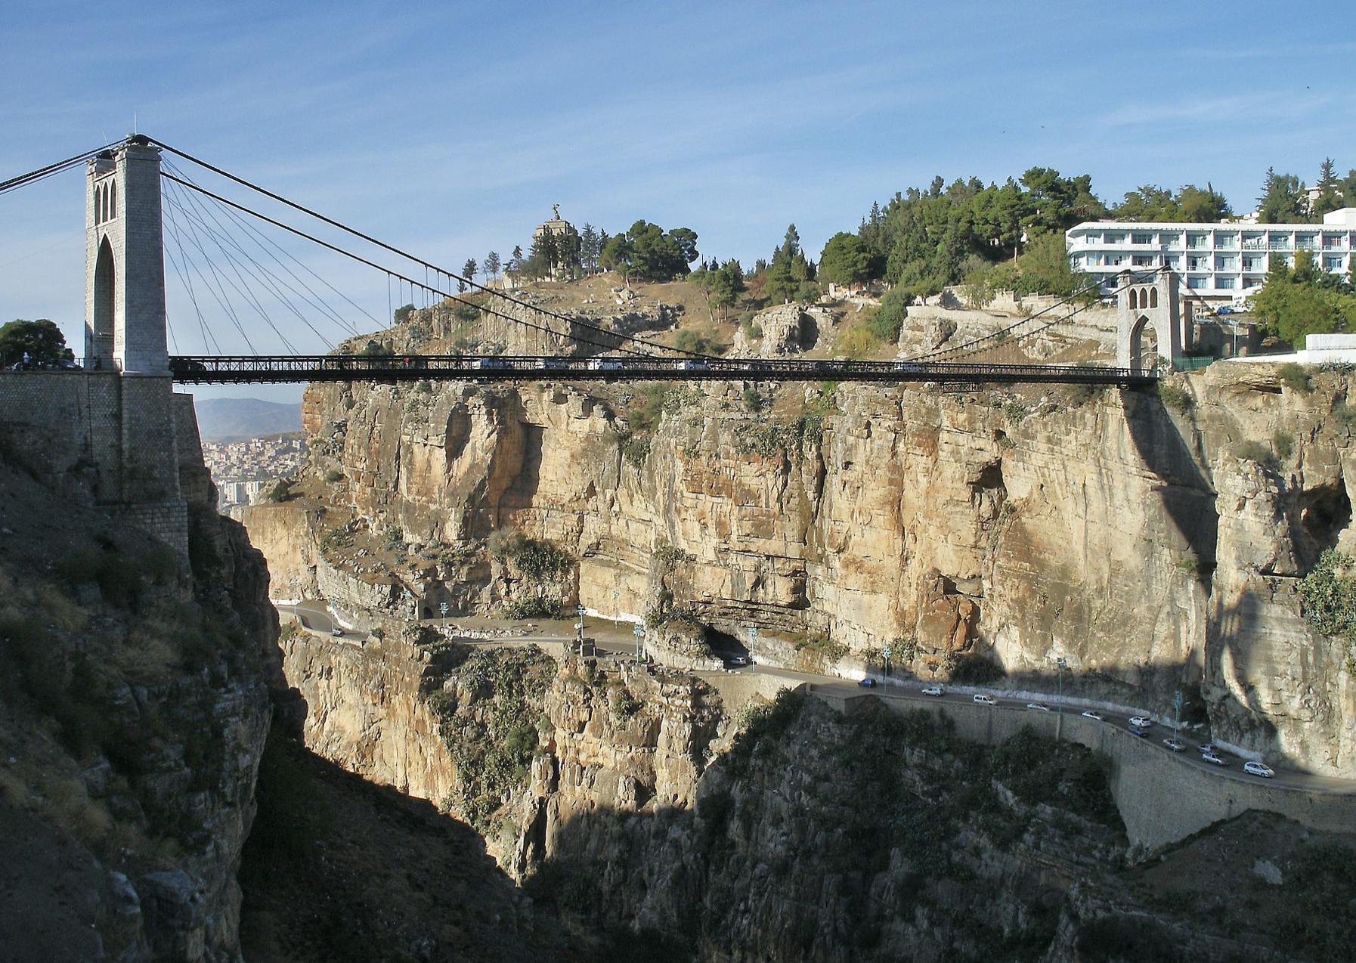
Notes:
Sidi M’Cid Bridge, Constantine, Algeria

Slide 21
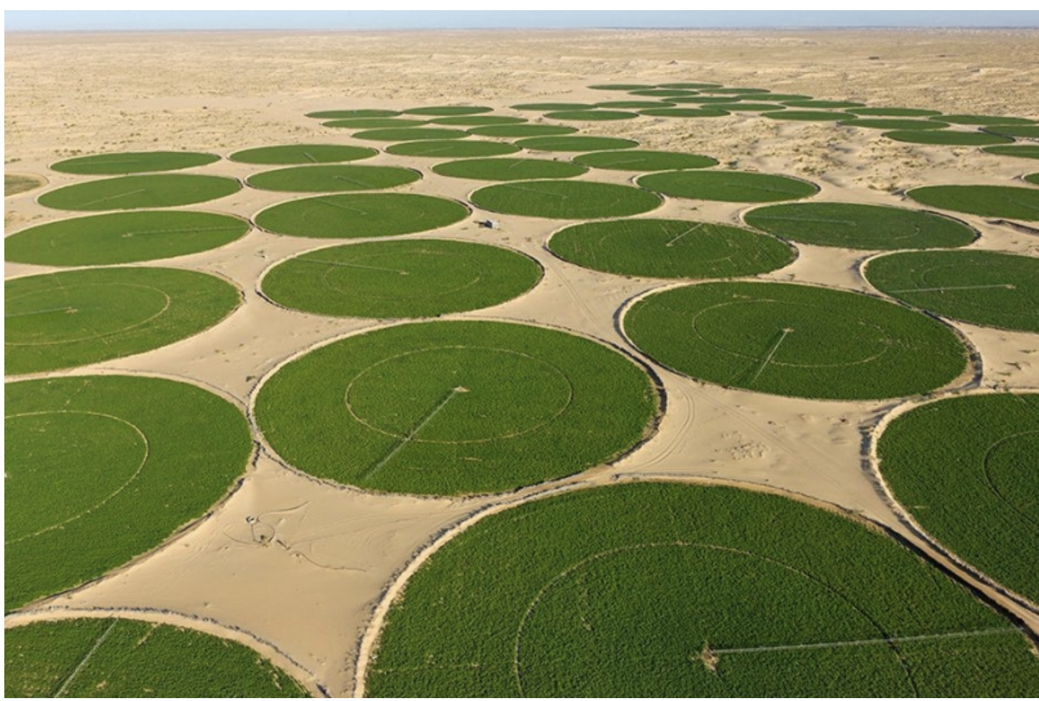
Notes:
Potato farming with circular irrigation, El Oued, Algeria

Slide 22
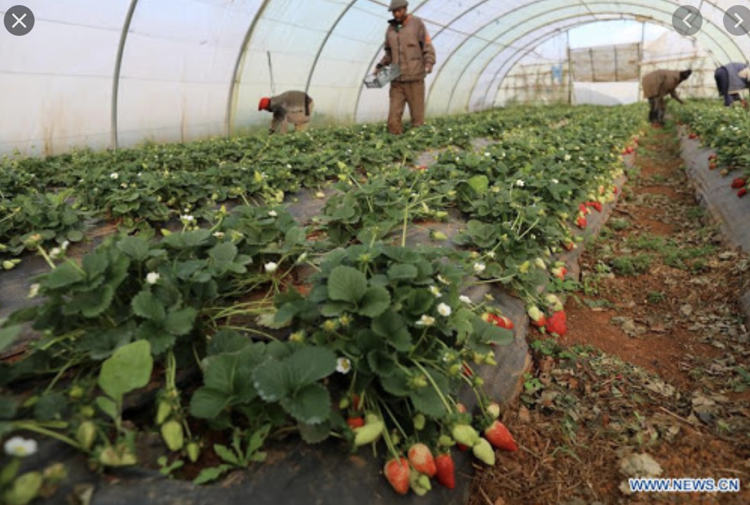
Notes:
Harvesting strawberries in Algeria

Slide 23
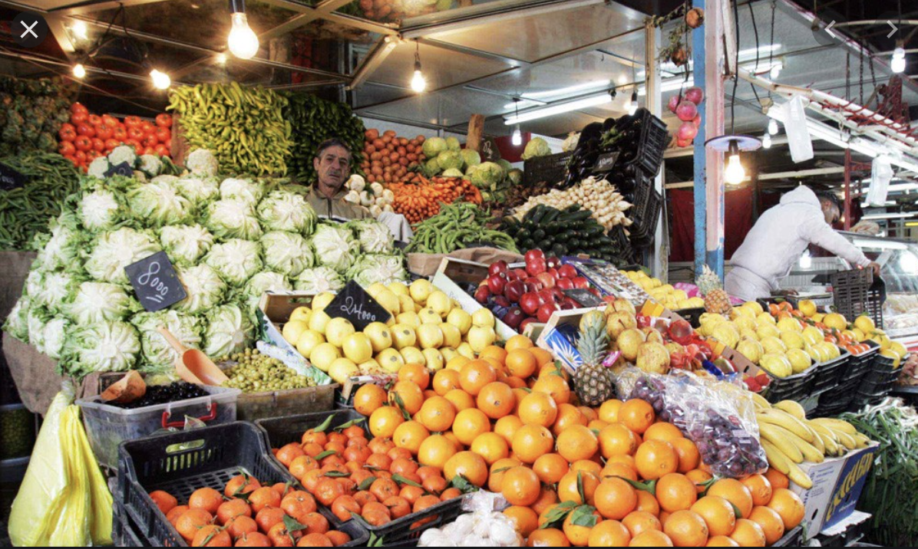
Notes:
Local market, Algiers, Algeria

Slide 24
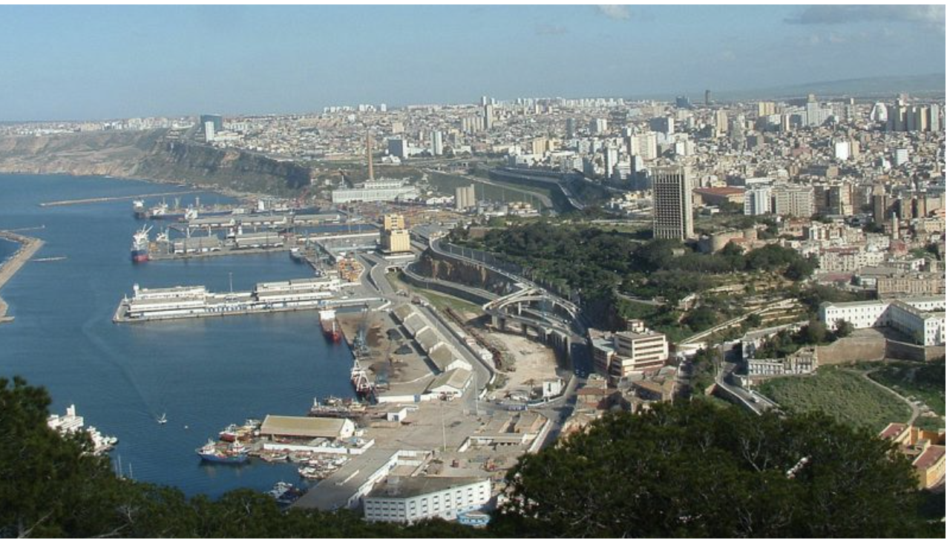
Notes:
Oran, Algeria

Slide 25
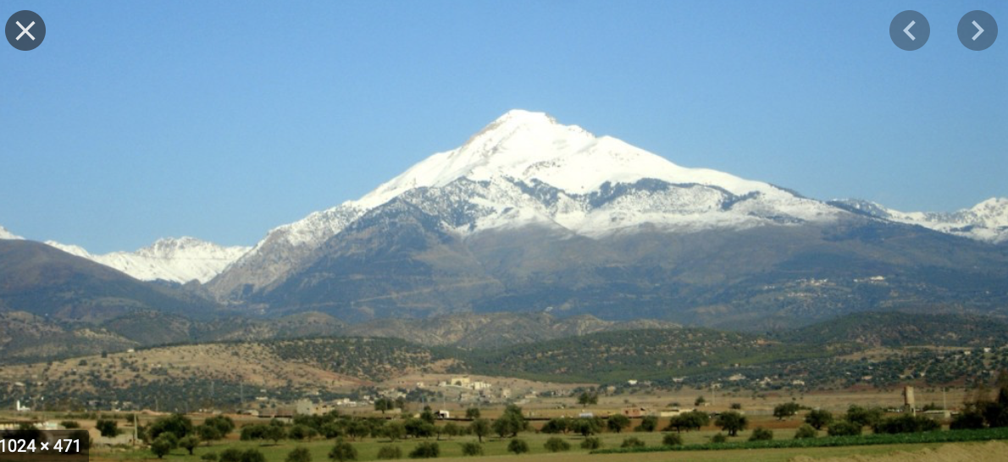
Notes:
Lalla Khedidja, Algeria

Slide 26
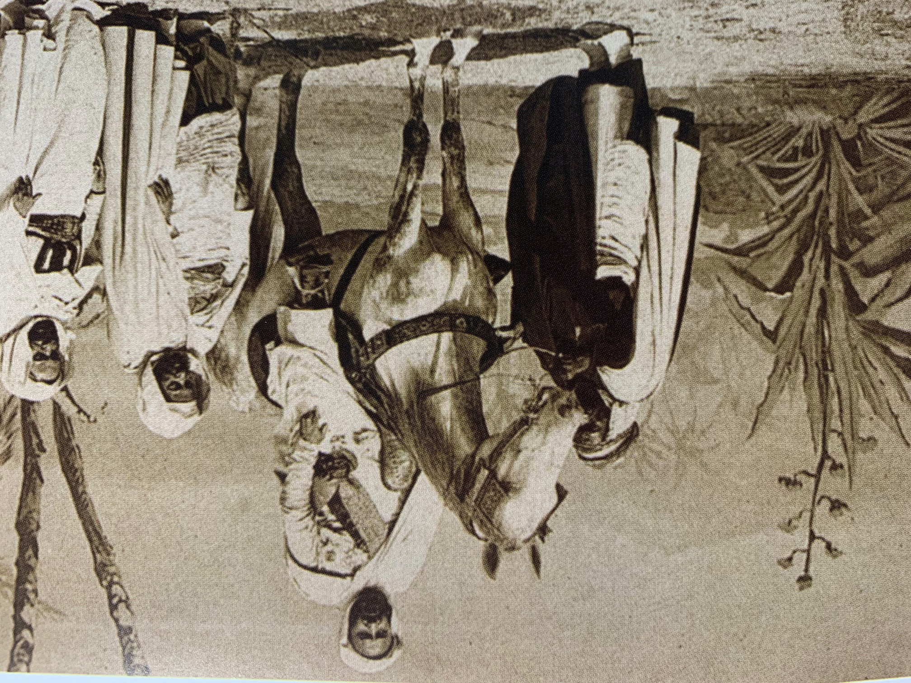
Stop and reflect:
What can you say about 19th century Algeria, the time and place in which Abd el-Kader lived?

Slide 27
Part II: Childhood
How did Abd el-Kader’s family prepare him for adulthood?

Slide 28
concept:
colonization
Definition: the action or process of settling among and establishing control over the indigenous (native) people of an area

Slide 29
Algiers
Mediterranean Sea
Notes:
By the time of Abd el-Kader’s birth, the Ottoman Empire was greatly reduced, and the Ottomans (Turks) were pulling out of northern Africa. France was anxious to hurry the remaining Ottomans along and establish a presence themselves. France attacked the port city of Algiers in 1830.

Slide 30
What skills and knowledge do you expect to receive instruction in by the age or 14 or so?
Notes:
Add: group discussion

Slide 31
Read, write, and speak clearly
Ride a bicycle
Keyboard/typing skills
Play piano; sing
Draw
Throw and catch balls
Cooperate with others
Advocate for self and others
Cleaning and cooking basics
Self care/hygiene
Learn how to be a caretaker of the earth and all living things

Slide 32
Kheira
first/favorite wife
Muhi al-Din
father
married
married
Abd el-Kader
Khadijah
sister
Lalla Zohra
mother
married
Ben Thami
brother-in-law
Notes:
Abd el-Kader had a huge “immediate” family, including at least two older brothers, three wives, and six children. The small grouping shown here are among the most influential in the emir’s life.

Slide 33
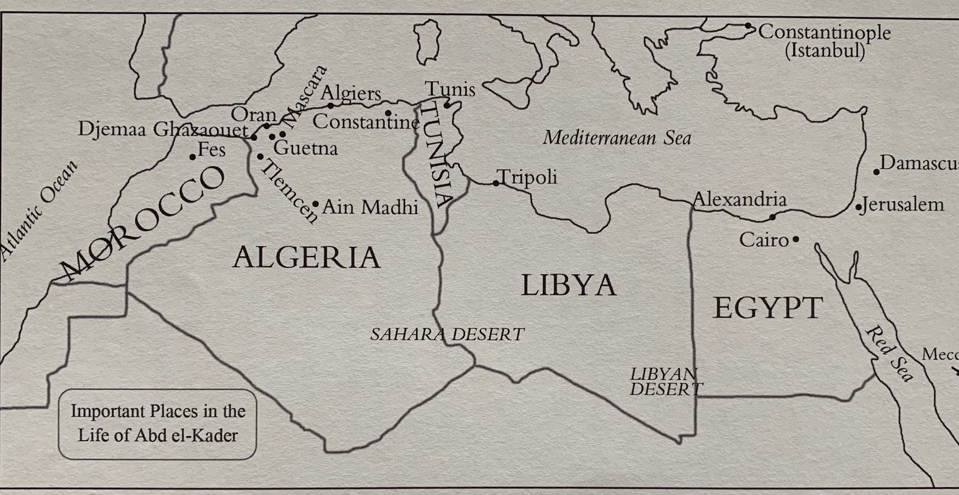

Slide 34
More details about Abd el-Kader’s childhood:
AEK’s mother taught him to read, to write, and to make his own clothes.
At age 13, AEK began to join in his tribe’s hunting expeditions. The hunt built qualities needed for life: intelligence, patience, endurance, and courage.
AEK Could recite the Qur’an by heart at age 14.
AEK was born into a marabout family. Marabout were expected to be literate and learned and disdainful of material things.

Slide 35
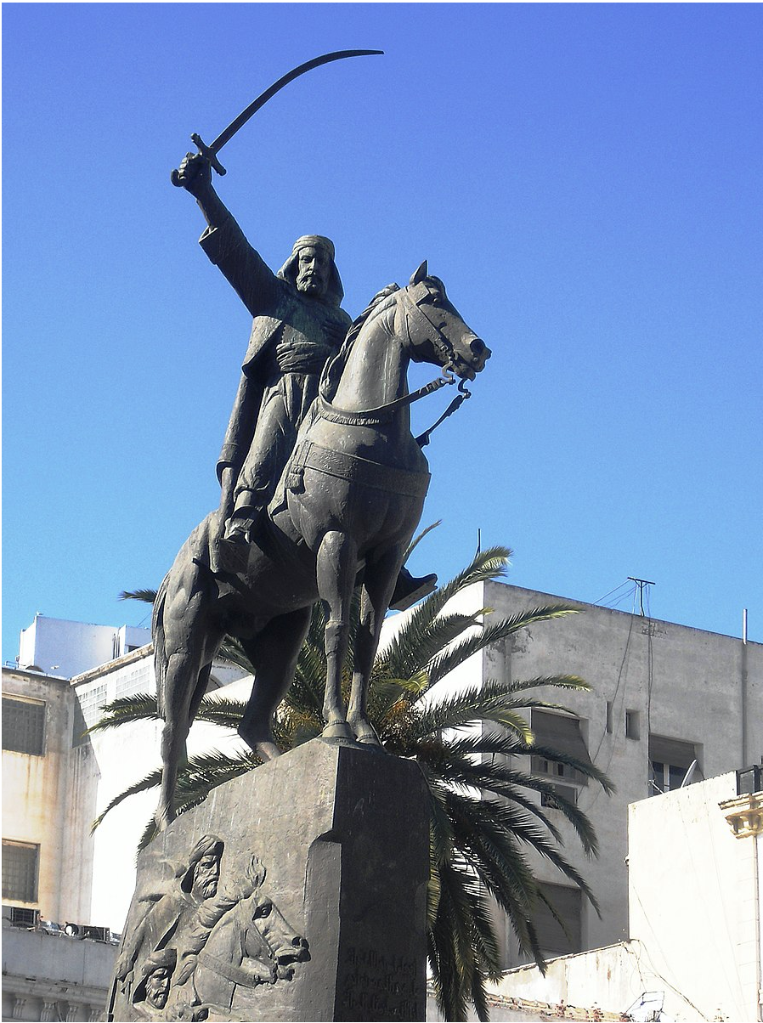
The Arabian Horse
Notes:
(Use this slide with extension activity on the Arabian horse.)

Slide 36
Stop and reflect:
How did Abd el-Kader’s family prepare him for adulthood?
How are you preparing to be the person you want to be?

Slide 37
Part III: Adulthood and Elkader
Warrior, protector, trailblazer--which word best describes Abd el-Kader?
Notes:
Today we’re going to follow Abd el-Kader into adulthood… and learn why the founders of a northeast Iowa town chose to name their town after him!

Slide 38
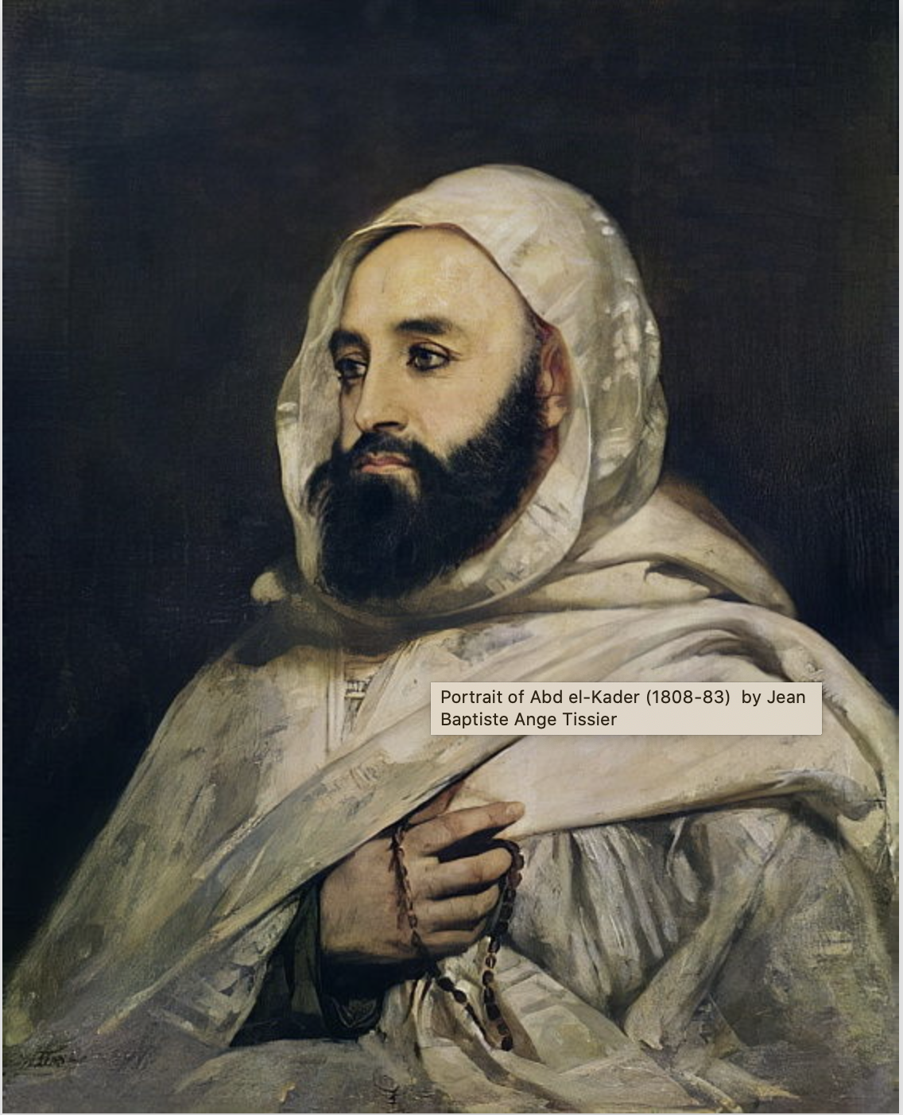
Stop & Reflect #1
Statue of the Emir Abd el-Kader, Algiers
Notes:
Here are two images of Abd el-Kader. The first is a statue of the Emir, created in 1987. It stands in the port city of Algiers, Algeria. The second image is a portrait of Abd el-Kader, painted during his lifetime, by the French painter Jean Baptiste Ange Tissier. The portrait hangs in the museum at the Palace of Versailles in France. Examine the two images. What details do you notice in each? How do the two pieces reflect the artists’ views of Abd el-Kader?

Slide 39
Statue of the Emir Abd el-Kader, Algiers
Notes:
We’ve learned about Abd el-Kader’s childhood, especially how his parents made sure he had the skills for leadership. (Ask students to refer to their Venn diagrams. Consider having volunteers share skills from Abd el-Kader’s side of the diagram they felt would help prepare him for leadership. Students should briefly justify their claims.) We’ve also learned that the French were actively trying to colonize Algeria. Let’s see what adulthood has in store for Abd el-Kader.

Slide 40
Abd el-Kader: a brief biography
Bio 1
Notes:
The following several slides contain a brief biography of Abd el-Kader. We’ll be going through it twice. Please put down your pencils and listen during the first reading. You’ll have time to fill in the worksheet during the second reading.

Slide 41
Bio 2

Slide 42
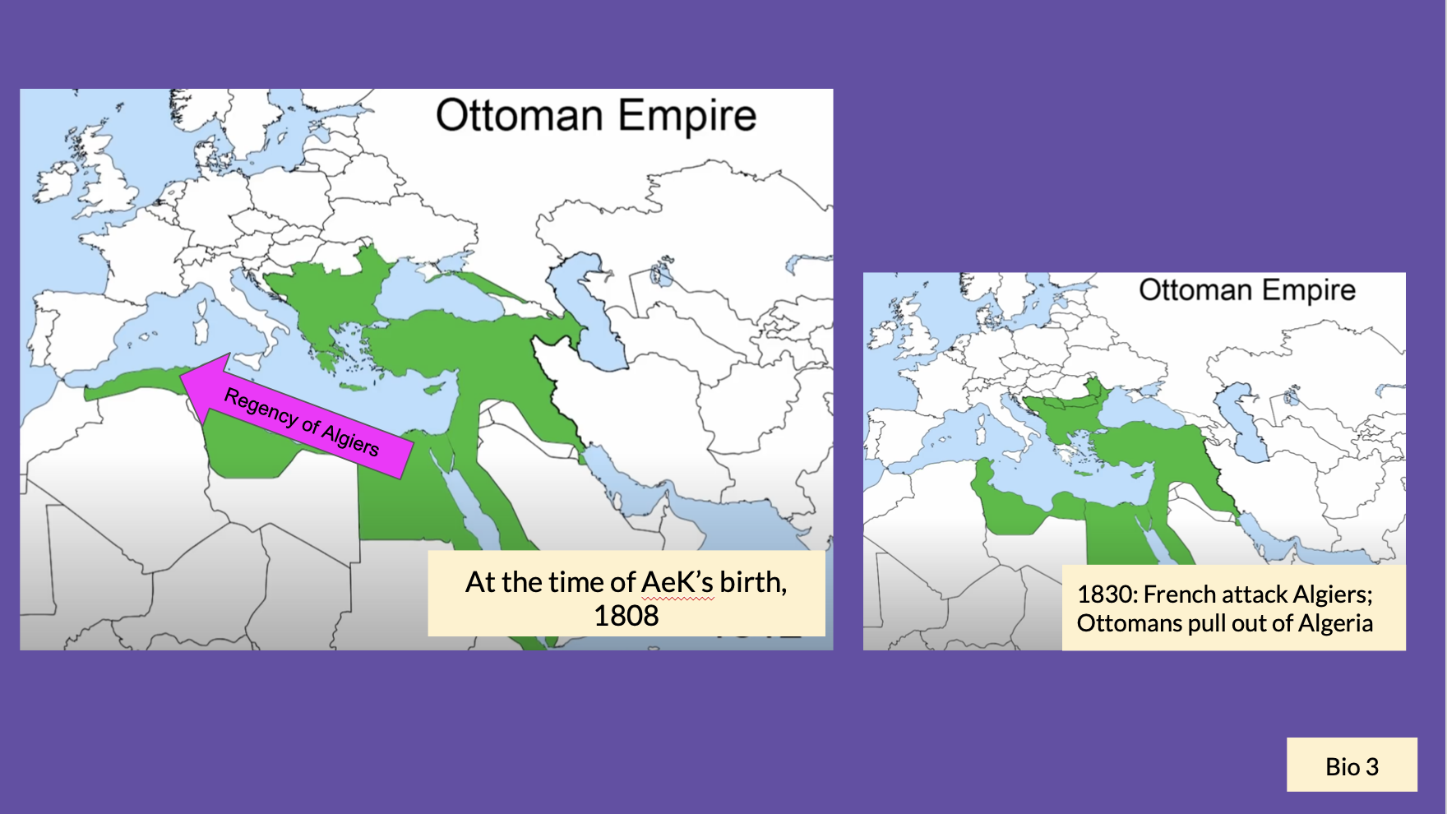

Slide 43
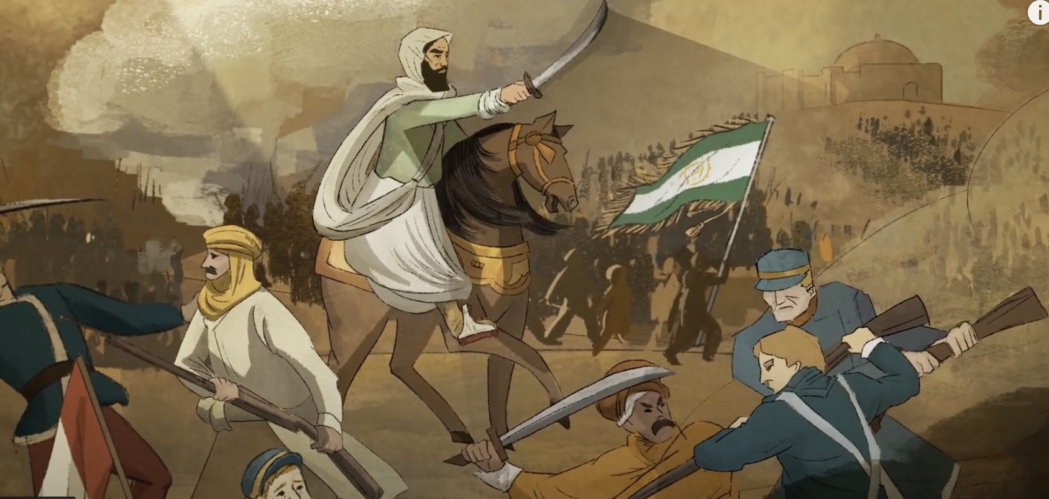
Bio 4

Slide 44
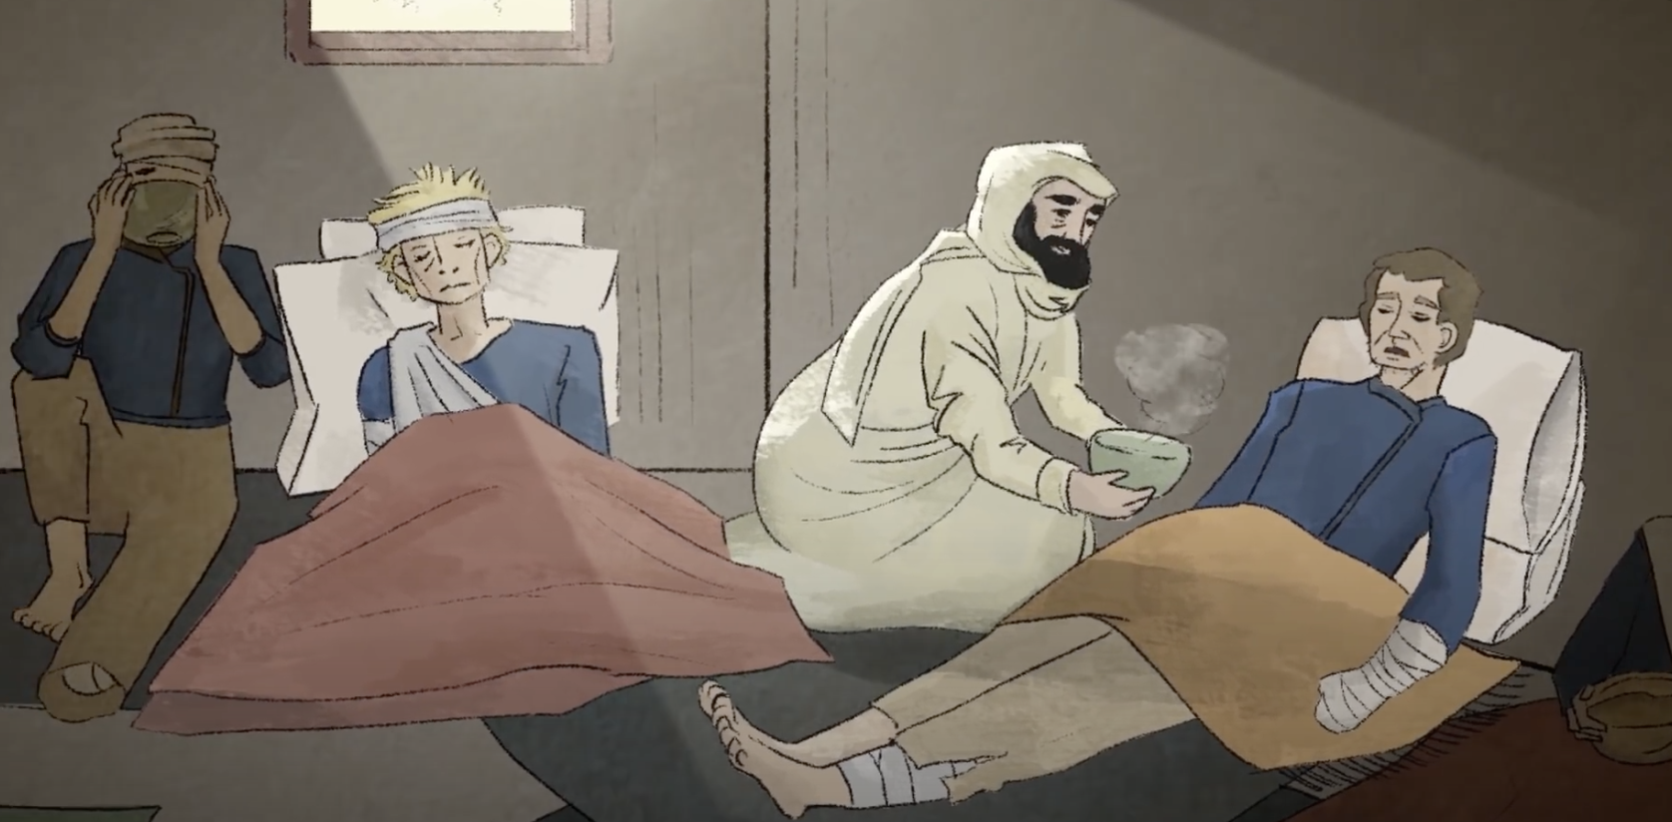
Bio 5

Slide 45
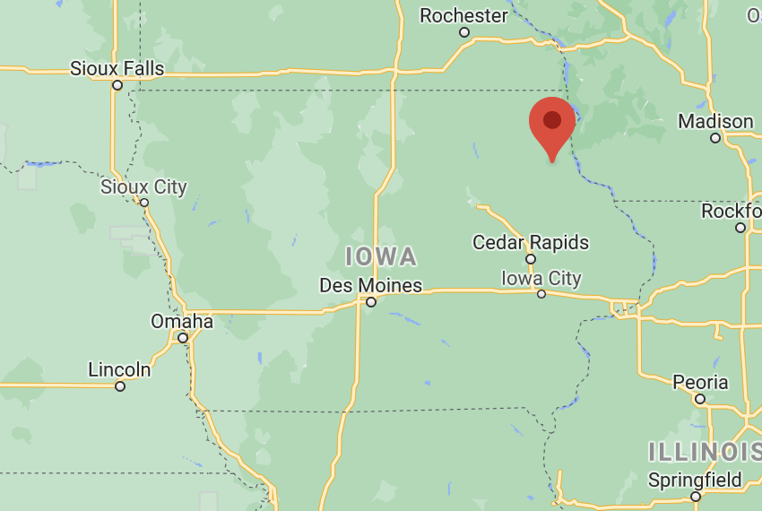
Elkader
Bio 6

Slide 46
Bio 7

Slide 48
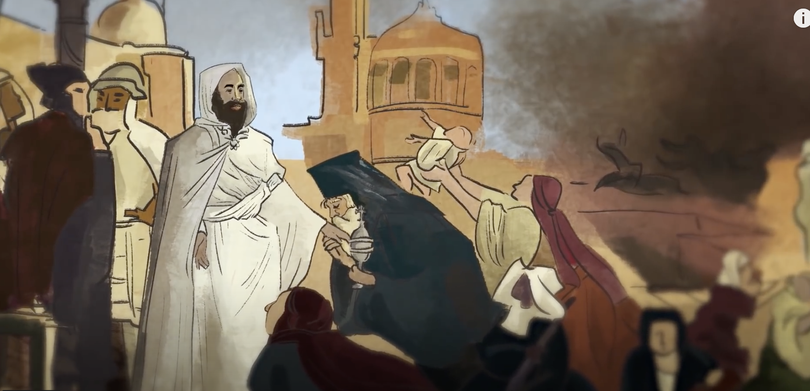
Bio 9

Slide 49
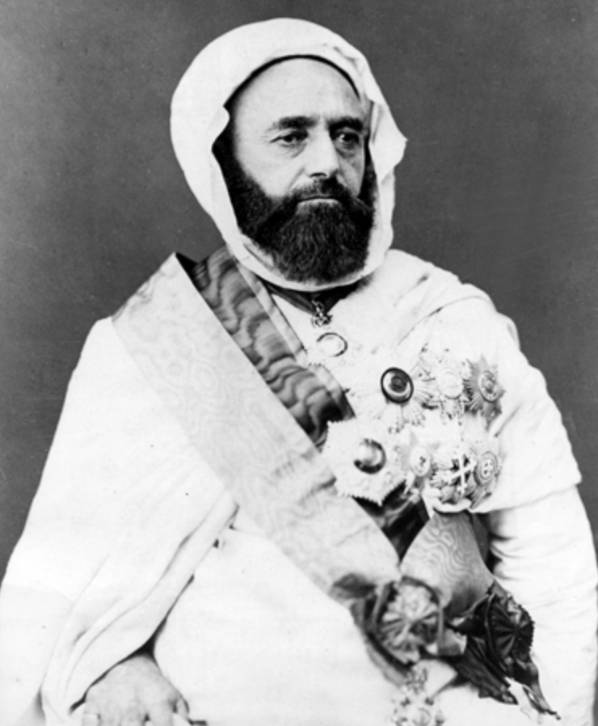
Bio 10

Slide 50
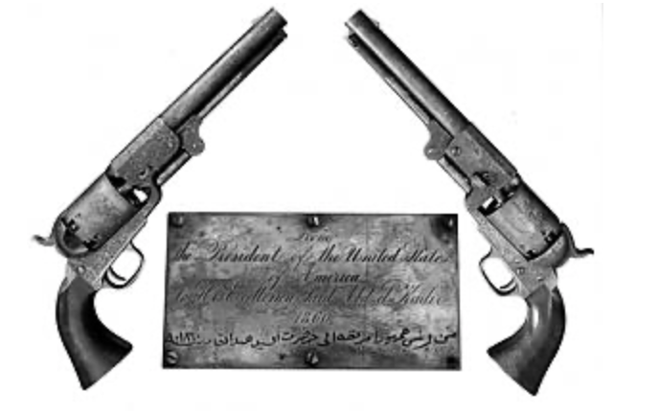
From the President of the United States of America
To His Excellency Said Abd el Kader
1860
Bio 11

Slide 51
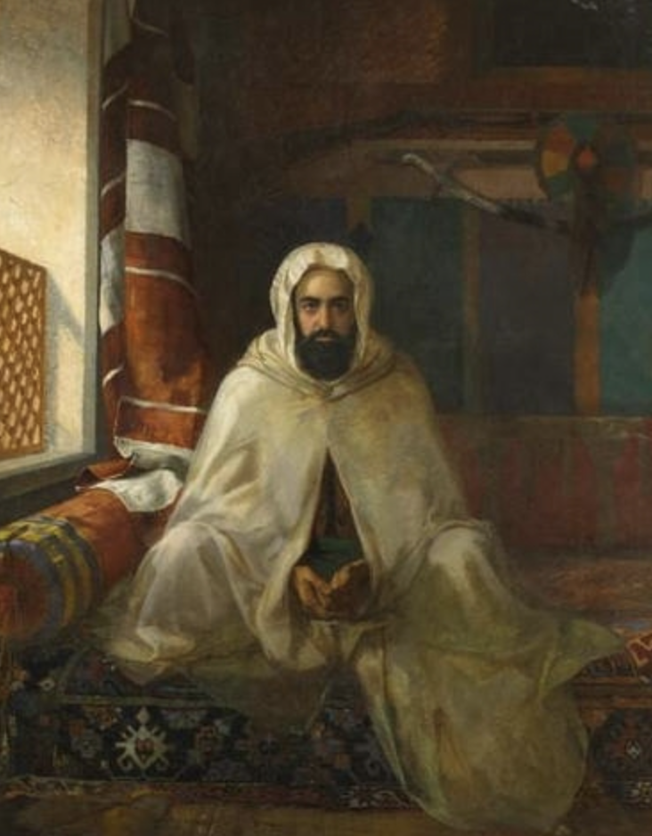
“The nobility of his character, no less than the brilliancy of his exploits in the field, long ago won for him the admiration of the world… Abd-El-Kader deserves to be ranked among the few great men of the century.”
New York Times, February 25, 1873
1808-1883
Bio 12

Slide 52
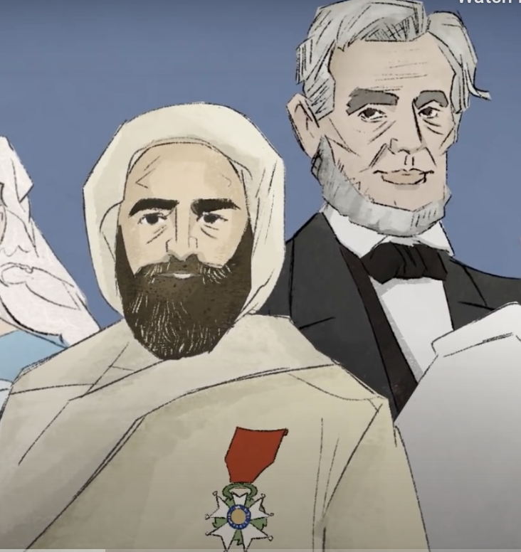
Stop & Reflect #2
What special qualities must Abd el-Kader have had to make him such a respected leader, even with no formal training in warfare?

